Slide 1
Data collection
Collecting data for training and testing
Xiaoyi Yang (Danny)

Slide 2
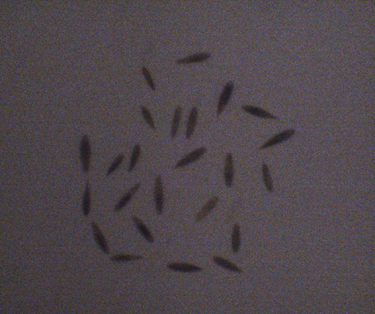
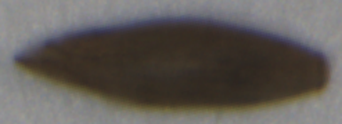
Data collection for training
Taking pictures.
Pictures through segmentation (data preparation), into processed images.
Images require each seed has never touched with other seeds.
->

Slide 3
Data collection for training: different datasets
The existing data: data has been prepared.
Using for early training.
The new data: data will be ready.
Collection done for minimum requirement.
More coming for testing.

Slide 4
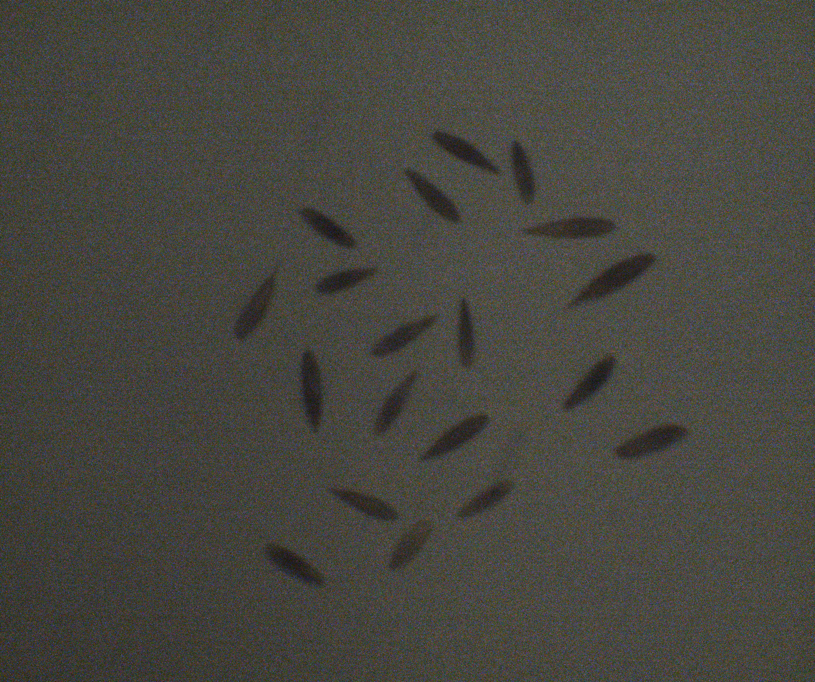
The first stage of data collection
Using camera from client.
Not a strong camera.
Image is not clear.
Increasing time of taking pictures.

Slide 5
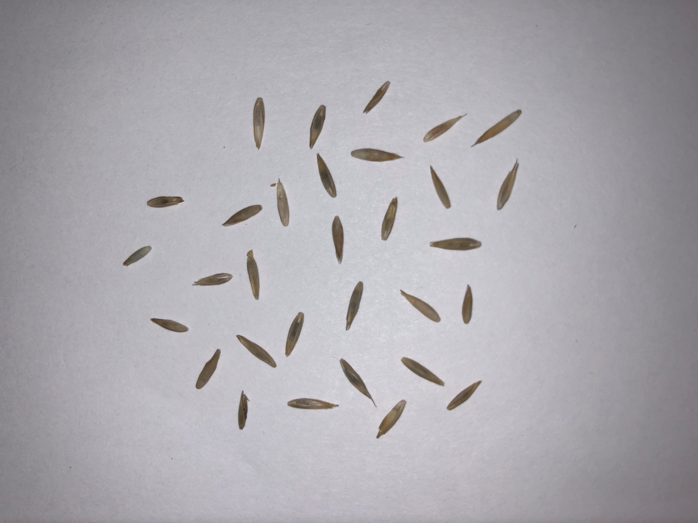
The second stage of data collection
Switch camera.
Images clearer enough.
Reducing time of collecting.
Resolution is high.

Slide 6
Data collection for training
We have done the minimum requirement of training

Slide 7
Data collection in the future
Additional collecting will be applied.
For additional training (if we have time).
For testing.
Three different ways of testing as early module test:
Pre-analysis without classification, pre-analysis with classification and mixed model testing (real-environment testing)

Slide 8
Image Processing
Group 11 - Green Team
VINAYAKA THOMPSON

Slide 9
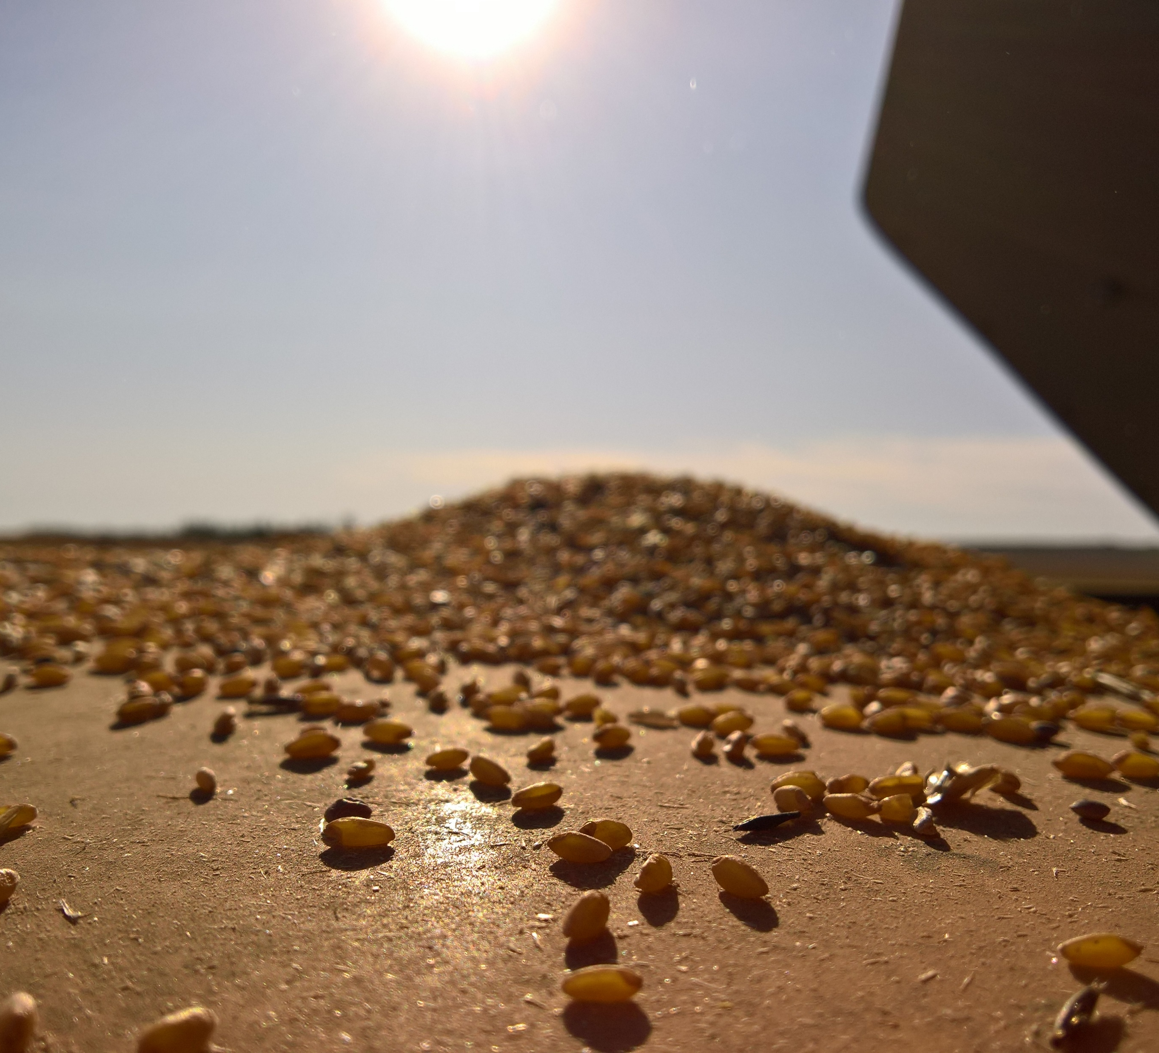
Progress made
Copious amounts of research
Installed OpenCV
Split seed pictures
Came up with image cleaning ideas

Slide 10
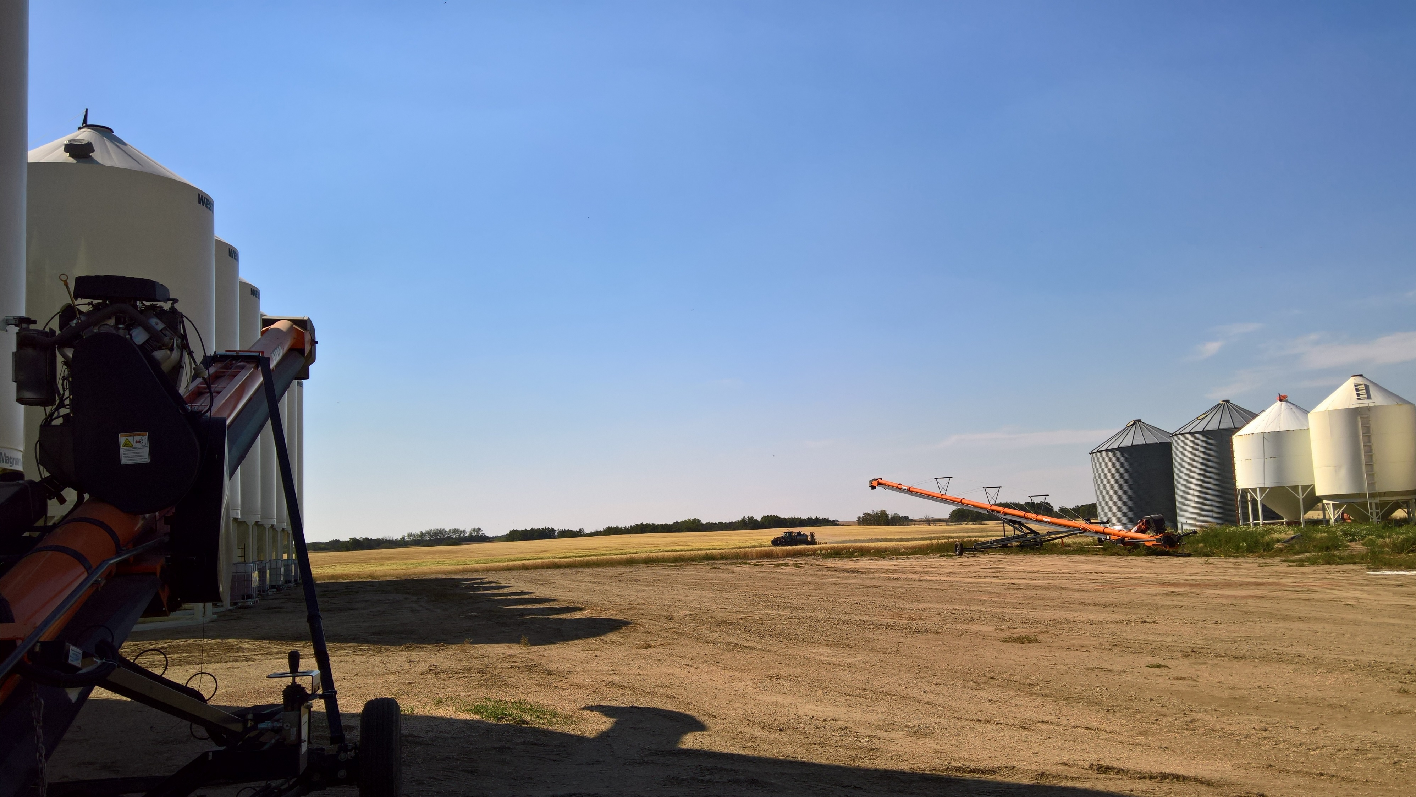
Complications
No experts
Took Extra time
Lack of testing device
Problem more challenging than imagined
Good Sources Hard to find

Slide 11
Complications - Research
Current version of OpenCV different
Most examples for 2.X

Slide 12
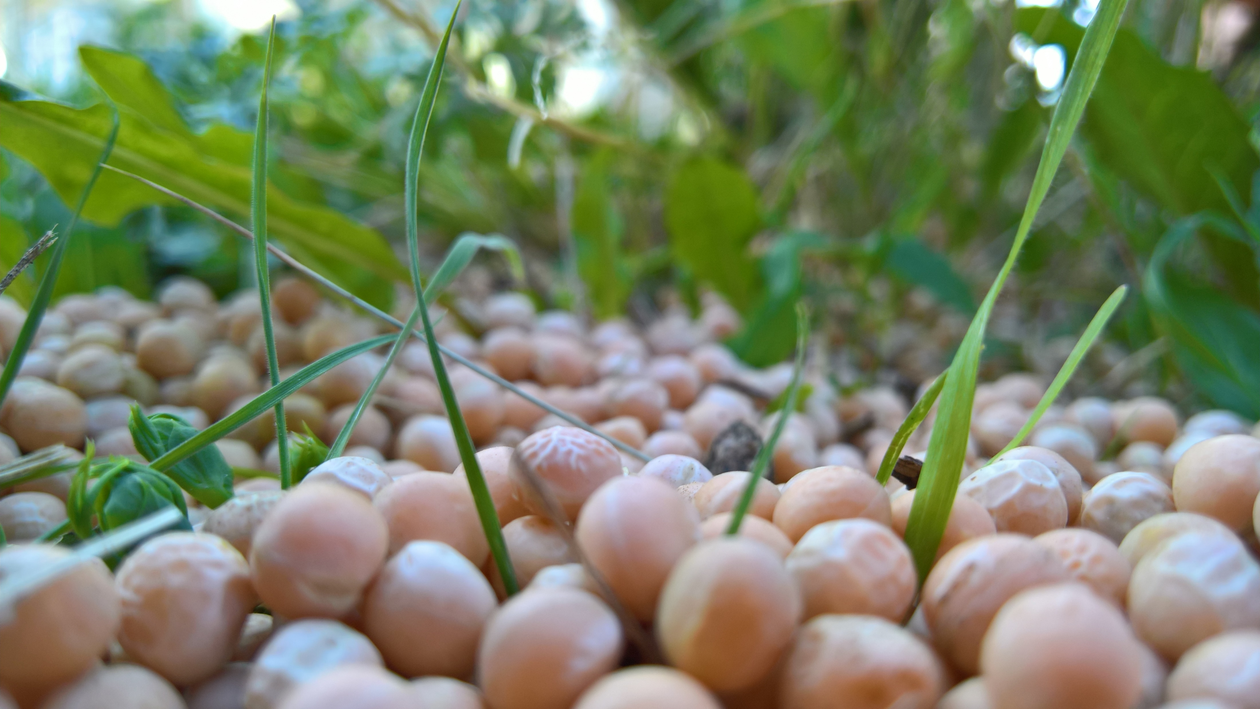
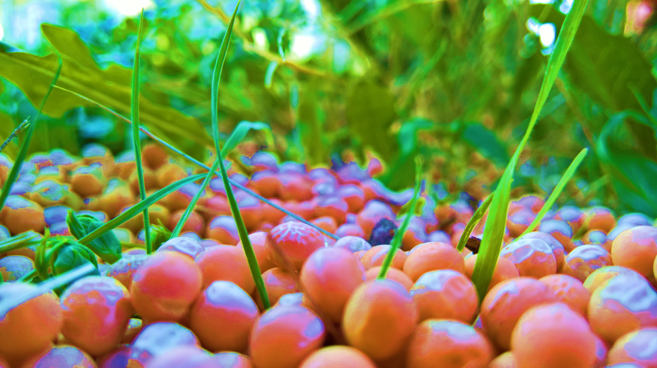
To Do: Image Cleaning
Extract lines
Change color weights
Black and white

Slide 13
To Do: Image Splitting
Identify seeds
Current detection method unreliable
Misses seeds
Thinks image noise is a seed
Clean image for better recognition

Slide 14
Data Training
Omar Elgebaly

Slide 15
Naïve--Bayes
Linear Model
Got 69% accuracy on Tall Fescue seed training and testing
Takes image data in as CSV format and analyzes the results using standard deviation and averages.
Will output the probability of an test image belonging to an image in the Training Set

Slide 16
Deep-Learning
Tensorflow is the framework we plan on using
Proving difficult to setup
Tensorflow model will likely be the core functionality of our product

Slide 17
Next Steps
Finish setting up Tensorflow and train the images with cuda enabled
Keep adding images and modifying parameters and weights until we achieve 75-80% accuracy
Pursue other models to compare to the deep learning model, ideally over spring break

Slide 18
Retrospective
Our communication this term has improved due to using a different medium of communication
Progress has been steady but needs to be ramped up.

